Slide 1

AMAZON SALES ANALYSIS REPORT
NANDANA GRACE JOHNY

Slide 2
Project Details
Project Title | Analyzing Amazon Sales data
Technologies | Data Science
Domain | E-commerce

Slide 3
Introduction
Sales management has gained importance to meet increasing competition and the need for improved methods of distribution to reduce cost and to increase profits. Sales management today is the most important function in a commercial and business enterprise.

Slide 4
Objective
Finding Sales-trend -> month-wise, year-wise, yearly month-wise

Slide 5
Tools Used
Microsoft Excel
Microsoft Power BI
Details of data
This is a Sales related dataset that contains Information like Sales Amt., Cost Amt., Item Type, Total Profit, Sales Region, Units Sold , Sales Channel etc.

Slide 6
Quick Insight
A quick insight for 2010-2017 Amazon sales.
137.35M
Total Sales
2857K
Sales Quantity
44.17M
Total Profit
513K
Total Units Sold
93.18M
Total Cost

Slide 7
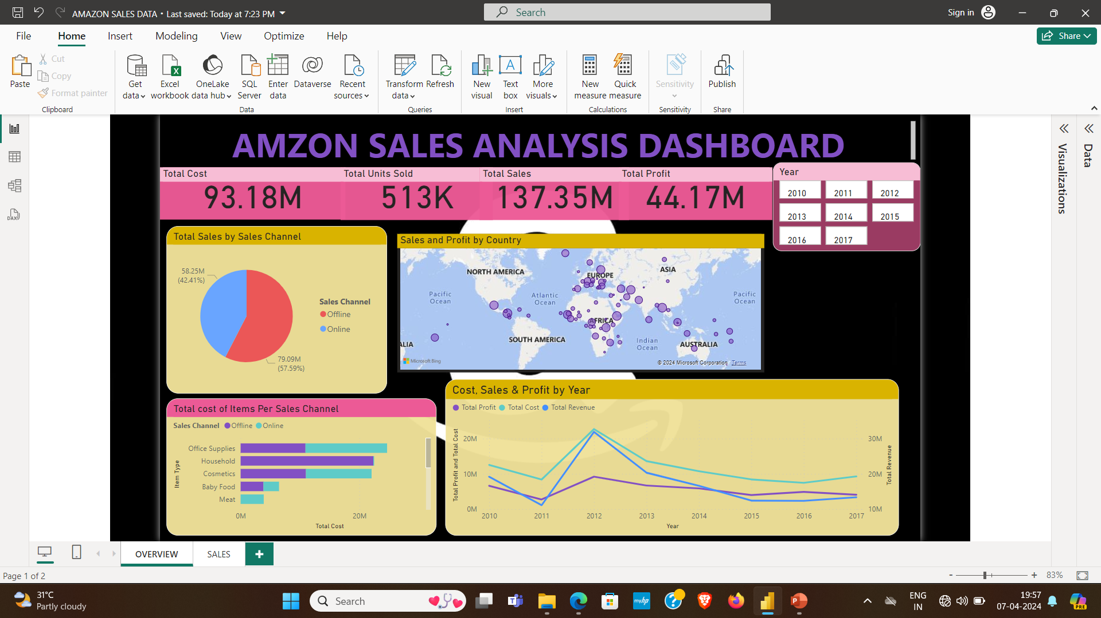
My Design

Slide 8
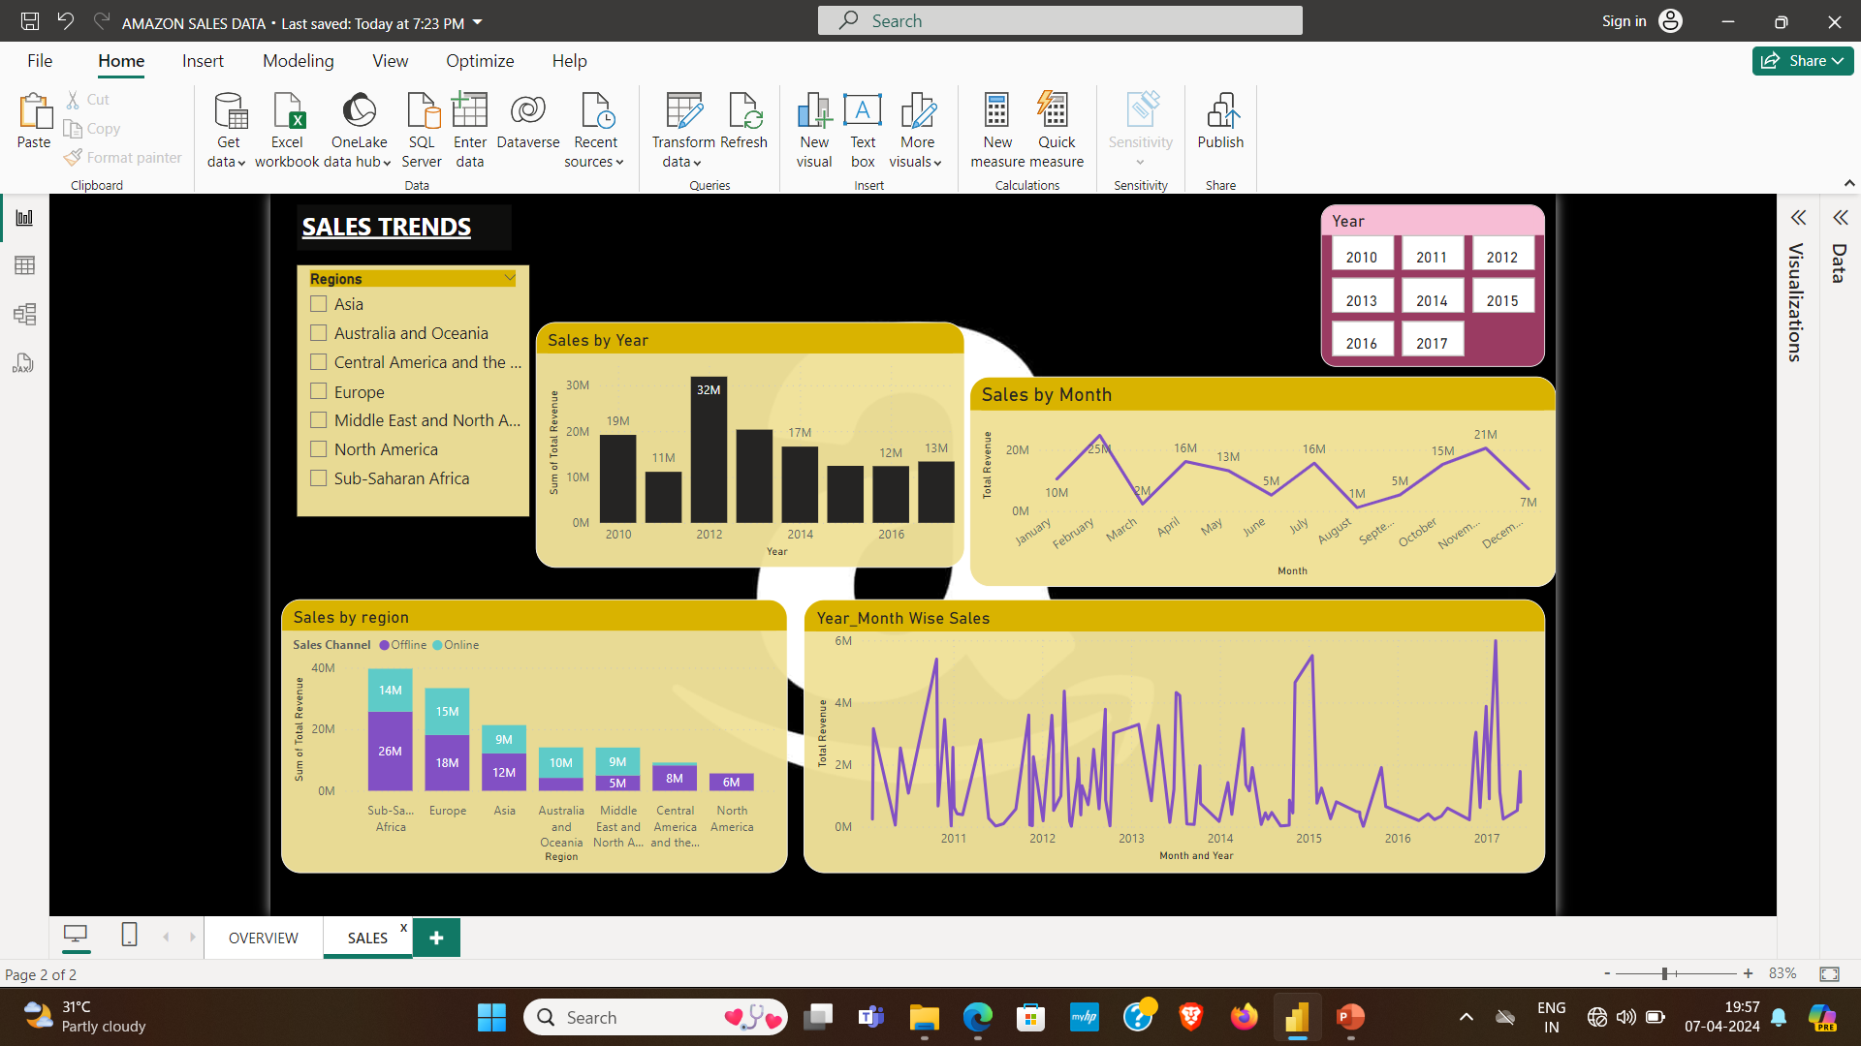

Slide 9
Conclusion
2012 has the highest revenue at 32M, followed by 2013 at 20M, and 2010 at 19M.
The sales for the Honduras are highest among all countries and lowest in Kuwait.
79.09M revenue are generated through offline channel and 58.25M are generated through online channel.
Sub-Sahara Africa region has highest revenue of 26M through offline channel and Europe region highest revenue of 15M through online channel.
Household and Office supplies items are highest selling products.

Slide 10
THANK YOU

